Slide 1
Normalized D-121 MAVG 50 Time Series Vector
Normalized D+75 MAVG 10
Time Series Vector
Normalized D-121 MAVG 50
Time Series Matrix
(11, 11)
D-121 MAVG 50
Convolved Matrix
(10, 10)
D-121 MAVG 50
Feature Vector
(25, 1)
D-121 MAVG 50
Feature Map
(5, 5)
.
.
.
.
.
.
.
.
.
Conv 2D + ReLU
Max Pooling 2D
Fully Connected Neural Network
upsampling architecture

Slide 2
MAVG 10 Output
121
195
Raw Time Series
. . . . . .
0
120
170
205
MAVG 50 Input

Slide 3
.
.
.
.
.
.
.
.
.
.
.
.
Input
(25, 1)
Layer 1
(25, 25)
Layer 2
(25, 100)
Output
(100, 75)

Slide 4
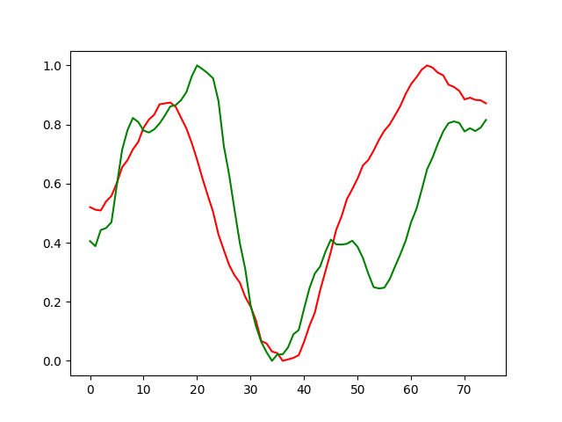
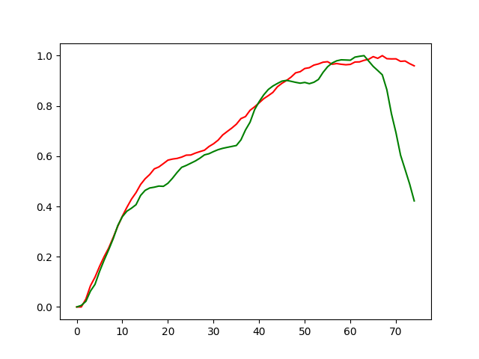
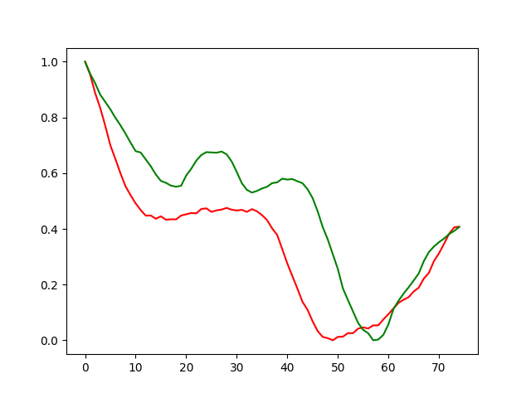
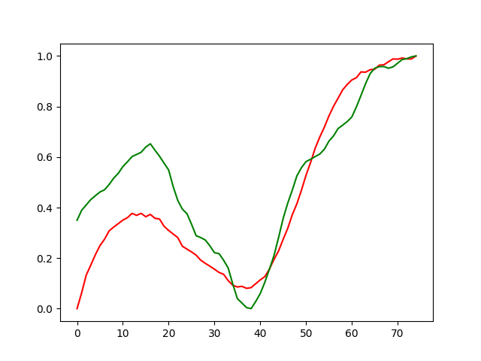
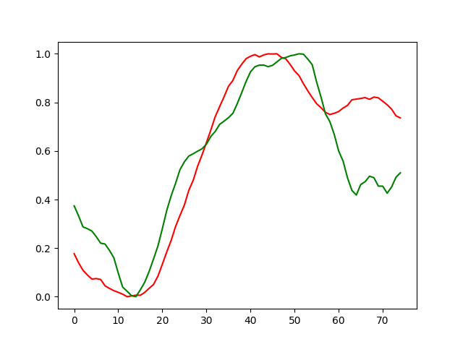
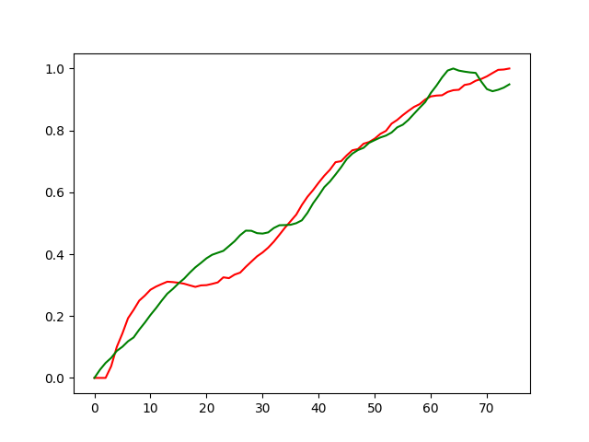
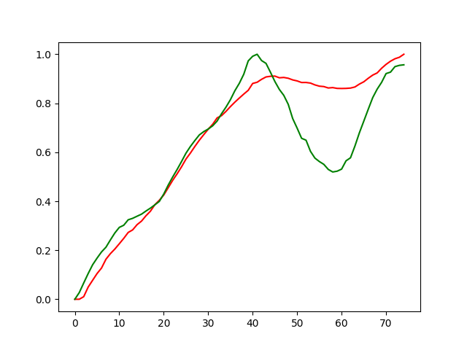
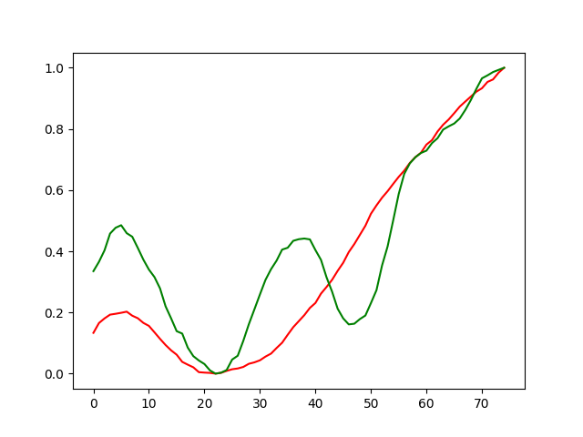

Slide 5
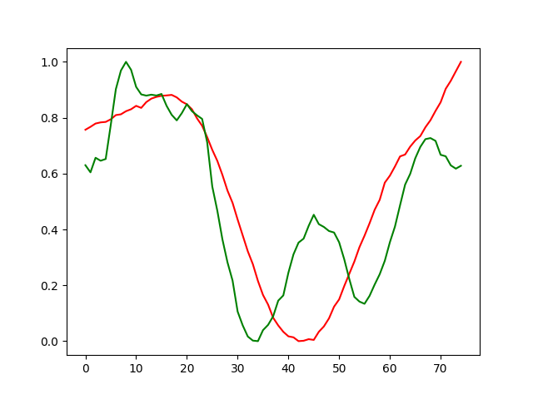
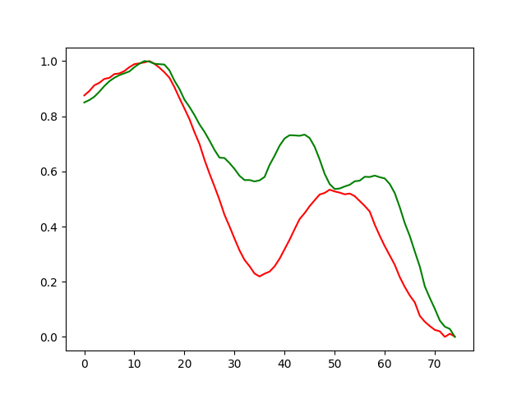
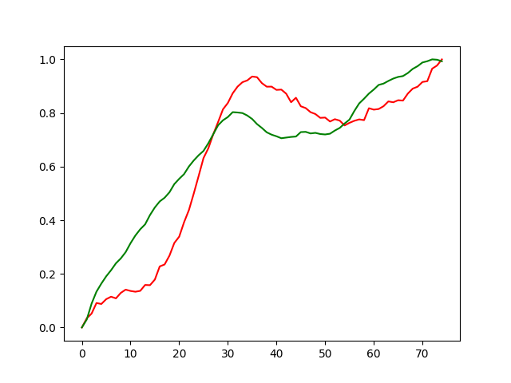
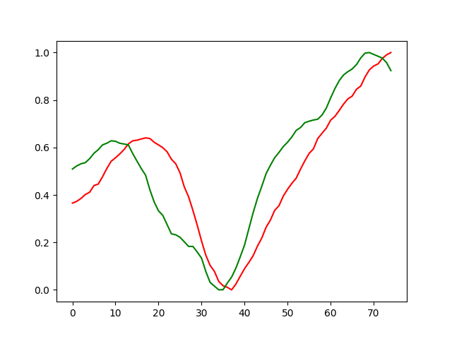
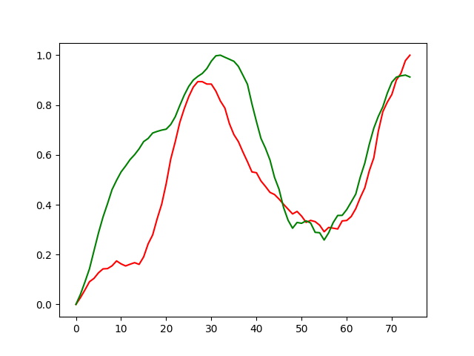
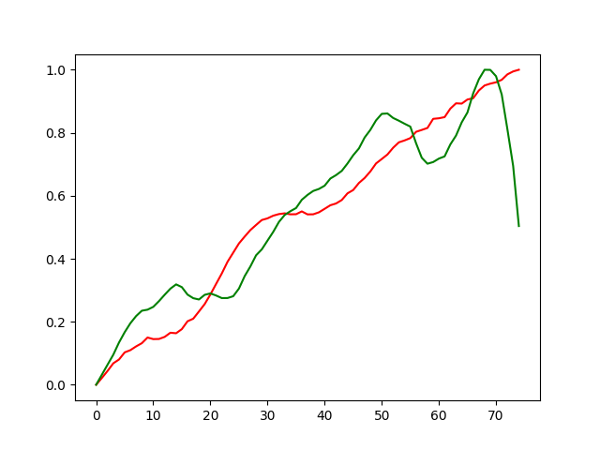
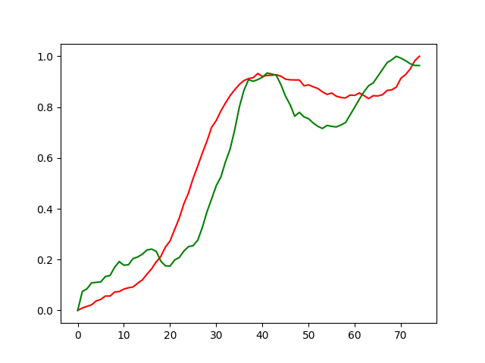
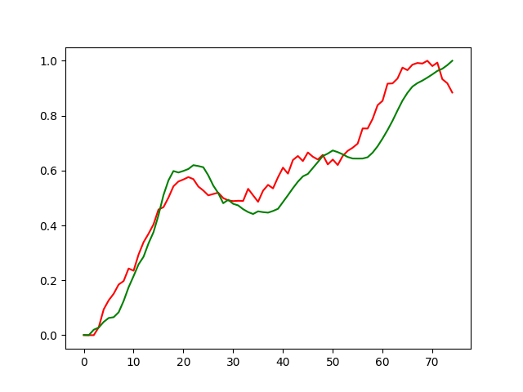

Slide 6
